Slide 1
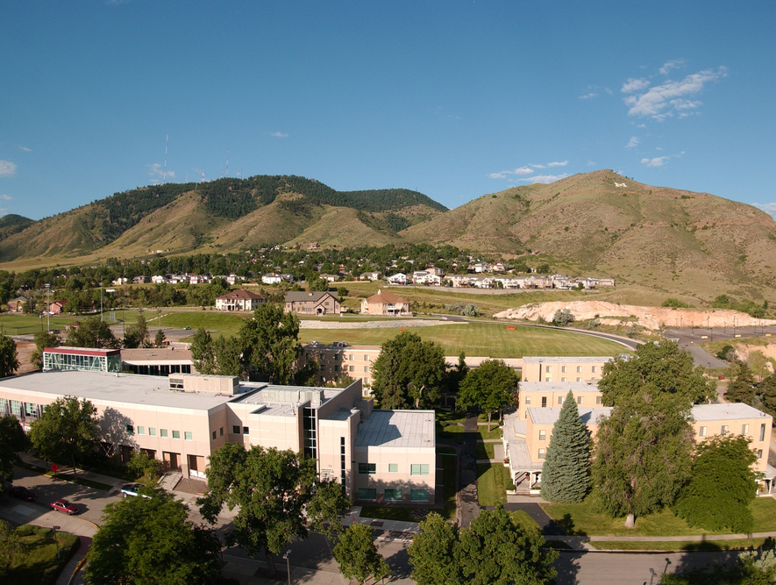
Colorado School of Mines
Computer Vision
Professor William Hoff
Dept of Electrical Engineering &Computer Science
http://inside.mines.edu/~whoff/

Slide 2
3D-2D Coordinate Transforms

Slide 3
3D to 2D Projections
We have already seen how to project 3D points onto a 2D image
We used the pinhole camera model
Also the geometry of similar triangles
Now we will look at how to model this using matrix multiplication
This will help us better understand and model:
Perspective projection
Other projection types, such as weak perspective projection
Special cases such as the projection of a planar surface

Slide 4
Intrinsic Camera Parameters
Recall the intrinsic camera parameters, for a pinhole camera model
Focal length f and sensor element sizes sx,sy
Or, just focal lengths in pixels fx,fy
Optical center of the image at pixel location cx, cy
We can capture all the intrinsic camera parameters in a matrix K

Slide 5
3D to 2D Perspective Transformation
We can project 3D points onto 2D with a matrix multiplication
We treat the result as a 2D point in homogeneous coordinates. So we divide through by the last element.

Slide 6
Complete Perspective Projection
To project 3D points represented in the coordinate system attached to the camera, to the 2D image plane:
To see this:

Slide 7

Extrinsic Camera Matrix
If 3D points are in world coordinates, we first need to transform them to camera coordinates
We can write this as an extrinsic camera matrix, that does the rotation and translation, then a projection from 3D to 2D
Namely, just take the first 3 rows of ${}_{W}^{C}H$

Slide 8
Complete Perspective Projection
Projection of a 3D point ^{W}P in the world to a point in the pixel image (x_{im},y_{im})
where K is the intrinsic camera parameter matrix
and M_{ext} is the 3x4 matrix given by

Slide 9
Example
Assume
Camera focal length is 512 pixels, image center (cx,cy)=(256,256)
Rotations are as shown
Position of vehicle with respect to world: (5,0,1)^{T}
Position of camera w.r.t. vehicle: (1,0,-2)^{T}
A camera is mounted on a vehicle. It observes a point P in the world at (X,Y,Z) = (16,0,0)^{T}. What pixel would P project to?
{C}
z
y
x
{V}
z
z
P
x
{W}

Slide 10
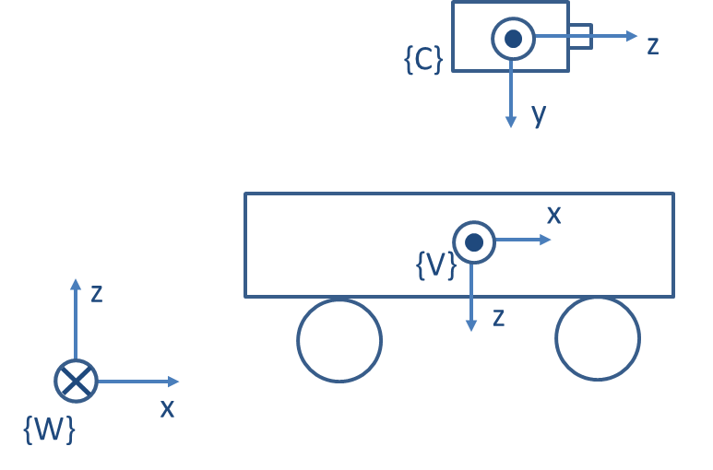
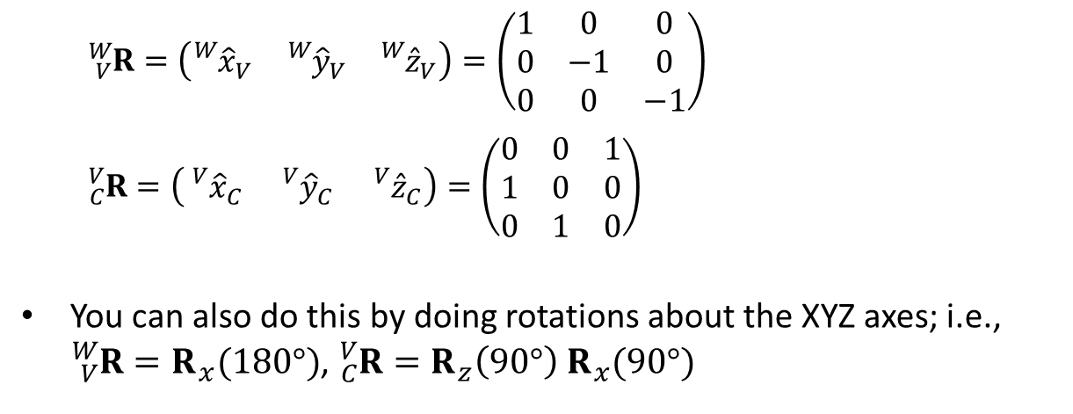
Example (continued)
We find the rotation matrices first
The easiest way to do this is to look at what the column vectors should be
${}_{V}^{W}{R=}\left(\begin{matrix}{}_{}^{W}{{\hat{x}}_{V}} & {}_{}^{W}{{\hat{y}}_{V}} & {}_{}^{W}{{\hat{z}}_{V}}\end{matrix}\right)=\left(\begin{matrix}1 & 0 & 0 \\ 0 & −1 & 0 \\ 0 & 0 & −1\end{matrix}\right)$
${}_{C}^{V}{R=\left(\begin{matrix}{}_{}^{V}{{\hat{x}}_{C}} & {}_{}^{V}{{\hat{y}}_{C}} & {}_{}^{V}{{\hat{z}}_{C}}\end{matrix}\right)}=\left(\begin{matrix}0 & 0 & 1 \\ 1 & 0 & 0 \\ 0 & 1 & 0\end{matrix}\right)$
You can also do this by doing rotations about the XYZ axes; i.e., ${}_{V}^{W}{R=R_{x}(180°)}$, ${}_{C}^{V}{R={R_{z}\left(90°\right) R}_{x}(90°)}$

Slide 11
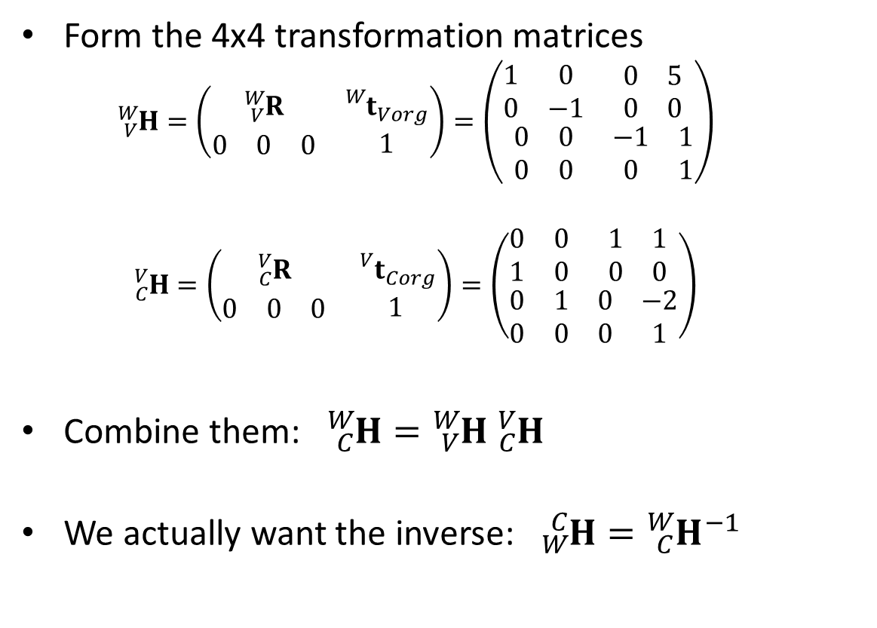
Example (continued)
Form the 4x4 transformation matrices
$${}_{V}^{W}{H=}\left(\begin{matrix}{}_{V}^{W}R & {}_{}^{W}{t_{Vorg}} \\ \begin{matrix}0 & 0 & 0\end{matrix} & 1\end{matrix}\right)=\left(\begin{matrix}\begin{matrix}1 & 0 \\ 0 & −1\end{matrix} & \begin{matrix}0 & 5 \\ 0 & 0\end{matrix} \\ \begin{matrix}0 & 0 \\ 0 & 0\end{matrix} & \begin{matrix}−1 & 1 \\ 0 & 1\end{matrix}\end{matrix}\right)$$
$${}_{C}^{V}{H=}\left(\begin{matrix}{}_{C}^{V}R & {}_{}^{V}{t_{Corg}} \\ \begin{matrix}0 & 0 & 0\end{matrix} & 1\end{matrix}\right)=\left(\begin{matrix}\begin{matrix}0 & 0 \\ 1 & 0\end{matrix} & \begin{matrix}1 & 1 \\ 0 & 0\end{matrix} \\ \begin{matrix}0 & 1 \\ 0 & 0\end{matrix} & \begin{matrix}0 & −2 \\ 0 & 1\end{matrix}\end{matrix}\right)$$
Combine them: ${}_{C}^{W}{H={}_{V}^{W}{H }{}_{C}^{V}H}$
We actually want the inverse: ${}_{W}^{C}{H={}_{C}^{W}{H^{−1} }}$

Slide 12
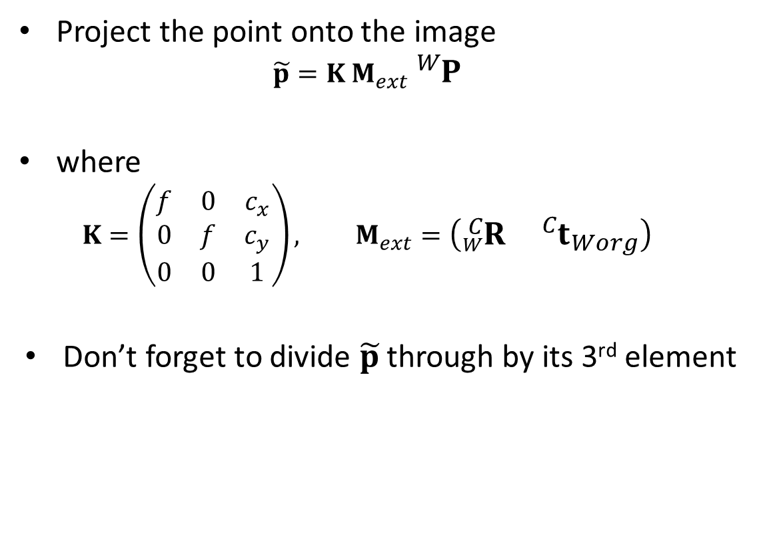
Example (continued)
Project the point onto the image
$$\tilde{p}=K M_{ext} {}_{}^{W}P$$
where
$$K=\left(\begin{matrix}f & 0 & c_{x} \\ 0 & f & c_{y} \\ 0 & 0 & 1\end{matrix}\right), M_{ext}=\left(\begin{matrix}{}_{W}^{C}R & {}_{}^{C}{t_{Worg}}\end{matrix}\right)$$
Don’t forget to divide $\tilde{p}$ through by its 3rd element

Slide 13
Partial Python Code
# Pose of vehicle to world. tv_w = np.array([[5.0, 0.0, 1.0]]).T # Get as a 3x1 matrix R_v_w = np.array(((1.0, 0, 0), (0, -1.0, 0), (0, 0, -1.0))) H_v_w = np.block([[R_v_w, tv_w], [0,0,0,1]]) # Get as 4x4 matrix print("H_v_w:"), print(H_v_w) # Pose of camera to vehicle. H_c_v = … # Pose of camera to world
H_c_w = H_v_w @ H_c_v
# Pose of world to camera
H_w_c = … f = 500.0 cx = 256.0 cy = 256.0 K = np.array(((f, 0, cx), (0, f, cy), (0, 0, 1))) Mext = H_w_c[0:3, :] print("Mext:"), print(Mext) P_w = np.array([16.0, 0, 0, 1]) p = K @ Mext @ P_w p = p / p[2] print("p:"), print(p)
Output:
Mext:
[[-0. -1. -0. -0.]
[-0. -0. -1. 3.]
[ 1. 0. 0. -6.]]
p:
[256. 406. 1.]

Slide 14
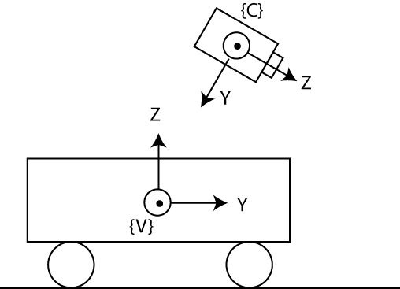
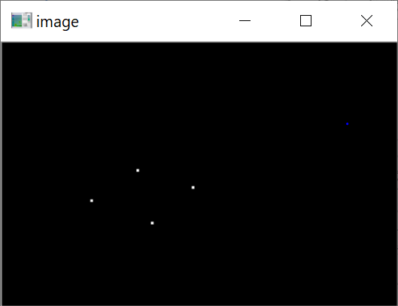
Example
Walk through the “3D to 2D transform Tutorial” (on the course Canvas website) to gain experience with performing 3D to 2D transformations!
14

Slide 15
Summary
We put camera intrinsic parameters (e.g., focal length and image center) into a 3x3 matrix K
We put camera extrinsic parameters (rotation and translation of the world-to-camera pose) into a 3x4 matrix Mext
We can project 3D world points onto an image by doing matrix multiplication: p = K Mext P
Remember to divide through by the last element of p

